Slide 1
Auto-feedback generator
Natural
Language
understanding

Slide 2
Agenda
Introduction
Dataset Information
Base Model Information
Fine-Tuning with LoRA
Evaluation Methods
Project Results and Plots
Structured Output
Conclusion

Slide 3
Introduction
This project aims to enhance automated feedback generation evaluation by fine-tuning a pre-trained Large Language Model (LLM) using Low-Rank Adaptation (LoRA). Automated feedback generation is a challenging Natural Language Understanding (NLU) task that requires models to assess coherence, grammar, relevance, and writing quality traits typically judged by human evaluators. To address this, we utilize a robust LLM as the Base(Flan-T5), capable of deep contextual understanding, and apply LoRA to fine-tune it efficiently on a domain-specific essay dataset.
Our primary objectives are:
To generate personalized, structured feedback for each essay, and
To maintain computational efficiency using parameter-efficient fine-tuning methods.
This project not only demonstrates the effectiveness of LoRA in adapting large models to specialized tasks with minimal overhead but also highlights the importance of structured output in real-world educational applications.

Slide 4
Dataset Information

Slide 5
Overview
Dataset Information
This project uses three complementary datasets to train and evaluate the model for essay scoring and feedback generation:
Persuade 2.0 Dataset
ASAP 2.0 Dataset
Persuade Corpus and Ellipse Corpus Combined Dataset

Slide 6
Dataset Information cont.
ASAP 2.0 Dataset
Structure:
essay_id: Essay Identifier
full_text: full essay text
score: Final score (range from 0 to 6)
assignment: Full prompt or writing assignment text
prompt_name Short name for the prompt
economically_disadvantaged: Whether the student is economically disadvantaged (Yes / No / Other)
student_disability_status: Whether the student is identified as having a disability
ell_status: ELL (English Language Learner) status (Yes / No / Other)
race_ethnicity Race/ethnicity of the student
gender: Gender of the student (M / F)
Source: Kaggle - ASAP 2.0: Automated Student Assessment Prize
Size: The dataset contains 24,728 rows

Slide 7
Dataset Information cont.
Persuade 2.0 Dataset
AES2-persuade
Structure:
essay_id: Essay Identifier
full_text: Full essay text
score: Final holistic score (range from 1 to 6)
prompt_name: Short name for the essay prompt
src: Data source origin
predicted: Boolean indicator of whether a prediction exists (true/false)
prompt_label: Numeric label representing the associated prompt bucket
Source: Kaggle - persuade-2.0
Size: The dataset contains 30,432 rows

Slide 8
Dataset Information cont.
Persuade 2.0 Dataset
persuade_2.0_human_scores_demo_id_github
Structure:
essay_id_comp: Essay identifier
full_text: Full essay text
holistic_essay_score: Holistic score assigned to each essay (range from 1 to 6)
word_count: Word count of the essay
prompt_name: Short name for the prompt
task: Type of essay task (Independent / Text dependent)
assignment: Full writing prompt or assignment text
source_text: Source material used for the prompt
gender: Gender of the student (M / F)
grade_level: Student's grade level
Source: Kaggle - persuade-2.0
Size: The dataset contains 26,000 rows

Slide 9
Dataset Information cont.
Persuade Corpus and Ellipse Corpus Combined Dataset
all_data
Structure:
essay_id: Unique identifier for each essay
full_text: Raw student essay text
holistic_essay_score: Final score given to each essay (range 1.0 to 5.0)
word_count: Number of words in the essay
prompt_name: Name of the assigned writing prompt
annotated_text: Essay text with embedded discourse annotations
discourse_count: Total number of discourse elements in an essay
effective_count: Count of discourse elements marked as "Effective"
adequate_count: Count of discourse elements marked as "Adequate"
Source: Kaggle - PERSUADE Corpus and ELLIPSE Corpus Combined
Size: 118 annotated training essays

Slide 10
Dataset Information cont.
Persuade Corpus and Ellipse Corpus Combined Dataset
holistic_scores
Structure:
essay_id: Unique essay identifier
full_text: Full text of the student essay
holistic_essay_score: Score assigned to each essay (range: 1 to 6)
word_count: Word count of the essay
prompt_name: Name of the essay prompt
Source: Kaggle - PERSUADE Corpus and ELLIPSE Corpus Combined
Size: 11,023 training essays

Slide 11
Dataset Information cont.
Persuade Corpus and Ellipse Corpus Combined Dataset
scores_arguments
Structure:
essay_id: Unique essay identifier
full_text: Full student essay text
holistic_essay_score: Holistic score assigned (range: 1 to 6)
word_count: Word count of the essay
prompt_name: Short name for the essay prompt
annotated_text: Full essay text with discourse annotations
discourse_count: Total number of discourse elements
effective_count: Number of discourse elements labeled as "Effective"
adequate_count: Number of discourse elements labeled as "Adequate"
Source: Kaggle - PERSUADE Corpus and ELLIPSE Corpus Combined
Size: 4,058 training essays

Slide 12
Dataset Information cont.
Persuade Corpus and Ellipse Corpus Combined Dataset
scores_ell
Structure:
essay_id: Unique essay identifier
full_text: Full student essay text
holistic_essay_score: Holistic score (range: 1 to 6)
word_count: Essay length in words
prompt_name: Essay prompt name
cohesion: Logical connectedness of ideas
Syntax: Sentence structure and complexity
vocabulary: Word choice variety and precision
phraseology: Use of idiomatic and academic expressions
• Source: : Kaggle - PERSUADE Corpus and ELLIPSE Corpus Combined
• Size: 334 training essays

Slide 13
Dataset Information cont.
The preprocessing pipeline begins by importing and loading multiple datasets from various sources, including ASAP 2.0 and several files from the Persuade 2.0 corpus and its extended versions. Initially, these datasets are standardized by renaming the column "holistic_essay_score" to "score" where necessary. The selected columns, "full_text" and "score," are then extracted and combined into a unified DataFrame.
To normalize the scoring range across different sources, MinMax scaling is applied to the main combined dataset as well as to a specific subset (df4) before it is merged. Afterward, the full dataset is cleaned by removing duplicates and any rows containing missing or empty essay texts.
The essays are then shuffled to randomize their order before being processed through a cleaning function. This function lowercases the text, removes HTML tags and URLs, filters out non-alphanumeric characters (excluding certain punctuation), and removes excess whitespace. Additionally, essays with fewer than 30 words are filtered out to ensure quality.
A minor manual correction is applied to the scores, replacing any instance of 0.25 with 0.20 to address a potential outlier issue.

Slide 14
Dataset Information cont.
We performed data augmentation by paraphrasing essays with underrepresented scores using a pretrained model, followed by the same preprocessing steps applied earlier.
To balance the dataset, we resample all groups to match the size of the smallest group, which has 1.0 samples. This size becomes our target. Each group is then adjusted to have the same number of samples as the target. If a group has fewer samples than the target, we increase its size by upsampling with replacement. Conversely, if a group exceeds the target size, we reduce its size through downsampling. After resampling, we combine all the groups into a single balanced dataset, ensuring equal representation from each group. This method eliminates bias from the dataset, leading to more accurate and fair analysis or model training.
We applied a feedback-generating function to create fixed feedback for each essay. Finally, we returned the feedback-balanced dataset while resetting the indexes to prevent index errors when handling it in the essay handler class.

Slide 15
Base Model Information

Slide 16
Overview
Base Model Information
FLAN-T5-base, developed by Google, is an efficient text-to-text Transformer model based on the T5 architecture. Unlike typical language models, it handles various NLP tasks, like translation, summarization, and question answering, as text generation tasks, enhancing its flexibility. Its effectiveness comes from fine-tuning on the FLAN dataset, improving zero-shot and few-shot learning. With around 220M parameters, its encoder-decoder structure and efficient tokenization allow strong performance without being overly large. While larger models may excel in raw text generation, FLAN-T5-base is a balanced choice for fast and reliable NLP applications.

Slide 17
Base Model Information cont.
Architecture:
Model Type: Transformer-based encoder model
Layers: 24 Transformer layers
Hidden Size: 1024
Attention Heads: 16
Total Parameters: ~1.5 Billion
Tokenizer: WordPiece-based with SentencePiece model
Max Sequence Length: 512 tokens
Key Innovations:
Disentangled Attention Mechanism: Separates content and position embeddings to improve context understanding.
Enhanced Mask Decoder: Designed to improve generalization and performance on downstream tasks.
Pre-trained with MLM Objective: Trained on massive English corpora (e.g., Books, Wikipedia, CC-News) to optimize for language understanding.

Slide 18
Base Model Information cont.
Capabilities:
Deep Language Semantics: Capable of understanding complex language patterns and nuances.
Superior Performance in NLU Benchmarks: Demonstrates strong results across natural language understanding tasks.
Effective Zero-Shot and Few-Shot Reasoning: Able to perform tasks with little to no task-specific training data.
Strong Base for Fine-Tuning: Provides a solid foundation for fine-tuning on tasks such as regression and classification.

Slide 19
Fine-Tuning with LoRA

Slide 20
Lora Overview
Fine-Tuning with LoRA
Low-Rank Adaptation (LoRA) is a parameter-efficient fine-tuning technique designed to adapt large pre-trained language models without updating all of their parameters. Instead of modifying the entire model, LoRA introduces small, trainable rank-decomposition matrices into each layer of the model’s attention mechanism. This drastically reduces the number of trainable parameters, making the fine-tuning process faster, more memory-efficient, and less prone to overfitting, especially beneficial when computational resources or data are limited.

Slide 21
Fine-Tuning with LoRA cont.
In our code, we fine-tuned a Flan/T5 model for Feedback generation using LoRA with the peft library. We started by loading the Base Flan/T5 model and then added LoRA adapters by wrapping it with get_peft_model, targeting the query , key and value layers in the self-attention modules.
We used LoraConfig with r=16, alpha=32, and task_type=“SEQ_2_SEQ_LM" to make it suitable for FeedBack Generating. The rest of the model remained frozen; only the LoRA parameters were trained.
we implemented a custom training loop in PyTorch. The FlanT5Generator class wraps a pretrained FLAN-T5 model for conditional generation tasks such as essay feedback. It uses the T5 architecture to generate textual outputs from encoded input sequences. The model is fine-tuned during training using cross-entropy loss between the generated and reference texts.
We also handled text preprocessing, tokenization, and dataset loading manually using a custom EssayDataset class, and we used multiple sources (ASAP, Persuade 2.0, etc) for robust training.
This setup allowed us to efficiently fine-tune the model with LoRA while keeping memory usage low and training time fast without modifying the full Flan/T5 parameters.

Slide 22
Evaluation Methods

Slide 23
Evaluation Methods
ROUGE-1 (Unigram Overlap): Measures the overlap of individual words (unigrams) between the generated feedback and the reference. Higher ROUGE-1 suggests better content coverage.
ROUGE-2 (Bigram Overlap): Captures the overlap of word pairs (bigrams), indicating fluency and the ability to form meaningful phrases. Higher ROUGE-2 means better coherence.
ROUGE-L (Longest Common Subsequence): Reflects how well the generated sequence preserves the order of words from the reference. Higher ROUGE-L implies better structural similarity and relevance.

Slide 24
Evaluation Methods cont.
We used three main metrics to evaluate our model’s performance on feedback generation: ROUGE-1, ROUGE-2, and ROUGE-L. These metrics measure the overlap between the generated feedback and human-written references, helping us assess content quality, fluency, and structure alignment.
We implemented a custom evaluation function to compute ROUGE scores on a validation set and monitored these scores epoch-by-epoch through our train_epoch loop.
This evaluation strategy, grounded in text similarity metrics, gave us a robust and interpretable measure of the model’s ability to produce high-quality, human-aligned feedback.

Slide 25
Evaluation Methods cont.
METRIC | Before | After
rouge1 | 0.119 | 0.983
rouge2 | 0.007 | 0.967
rougeL | 0.079 | 0.983
This table compares the evaluation metrics of the Flan/T5 model and the LoRA fine-tuned model.
It highlights how fine-tuning with LoRA led to significant improvements in prediction accuracy and overall performance.

Slide 26
Project Results and Plots

Slide 27
Overview
Project
Results and Plots
For our project results, we performed a comparative analysis between the Base FLAN-T5 model and the LoRA fine-tuned version. Quantitatively, we observed clear improvements across all evaluation metrics—ROUGE-1, ROUGE-2, and ROUGE-L—after applying LoRA.
The fine-tuned model produced higher
ROUGE-1, ROUGE-2, and ROUGE-L scores demonstrated significantly better alignment with the essay quality scores, highlighting their enhanced ability to capture the nuances of essay quality.

Slide 28
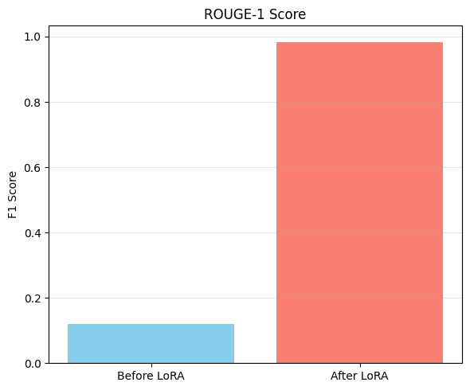
Project
Results and Plots
The graph shows how much our model improved after applying LoRA. On the left, the "Before LoRA" bar represents the MSE when we only used the Flan-T5 model without any fine-tuning.
It was pretty Low, around 0.119, meaning the model’s predictions for Feedbacks were quite far off from the actual Feedback. After we fine-tuned just the LoRA parameters, shown by the "After LoRA" bar on the right, the Rouge-1 improved drastically to 0.983
That sharp increase shows how effective LoRA was in helping the model adapt to the feedback generation task without needing to retrain the whole model. It’s a clear indicator that fine-tuning even a small set of parameters with LoRA made a huge difference in prediction accuracy.

Slide 29
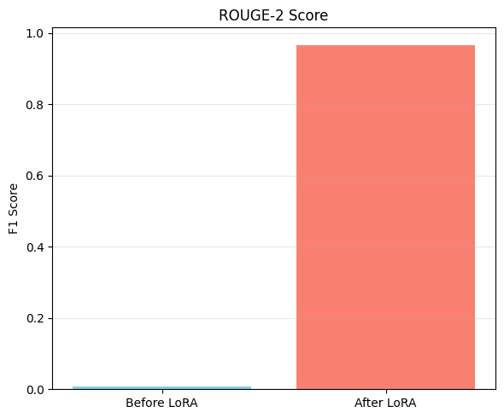
Project
Results and Plots
The graph clearly shows how much our model improved after applying LoRA, this time using the Rouge-2 metric. On the left, the "Before LoRA" bar represents Rouge-2 when we used the Flan-T5 model without any fine-tuning.
The error was quite Low, around 0.007 which means the model’s generation of the feedbacks were often far from the actual feedback. After fine-tuning just the LoRA parameters, as shown by the "After LoRA" bar on the right, the Rouge-2 improved significantly to 0.967.
The increase in Rouge-2 highlights how effective LoRA was at improving the model’s generation consistency and reliability, without the need to retrain the entire model.
It proves that even minimal parameter updates through LoRA can lead to substantial performance gains.

Slide 30
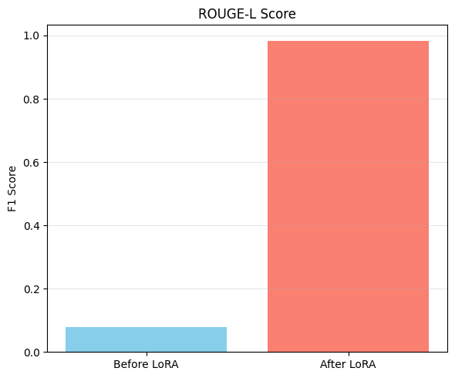
Project
Results and Plots
This graph highlights how much better our model got at explaining the variation in Feedback generation after applying LoRA.
The "Before LoRA" bar shows the Rouge-L of the Flan-T5 model, which was quite low around 0.076.
That Low value means the model was doing very bad at generating feedbacks, clearly struggling to learn anything useful. But after fine-tuning with LoRA, the Rouge-L jumped to about 0.983.
It’s strong evidence that LoRA helped the model truly understand the essay and feedback patterns without needing to update the entire network.

Slide 31
conclusion
In conclusion, our project successfully demonstrated how LoRA fine-tuning can significantly improve the performance of a large pre-trained language model like FLAN-T5 on the task of automated feedback generation. By selectively training only a small number of parameters, we achieved remarkable gains in accuracy and generalization, as evidenced by the significant improvements in ROUGE-1, ROUGE-2, and ROUGE-L scores.
The visual comparisons before and after LoRA tuning clearly show how the model's predictions became more aligned with actual scores, proving the effectiveness of parameter-efficient fine-tuning.
Overall, our results highlight not only the practicality of LoRA in low-resource settings but also its potential for enhancing fairness and reliability in educational NLU applications.

Slide 32
Thank you

